Slide 1
In The Name of God
Collage of Engineering
Computer Engineering
Department
Diyala University
CMOS Properties
Lecture Seven
1

Slide 2
Static power dissipation is actually not zero – culprit is leakage current.
A single inverter can theoretically drive an infinite number of gates and still be functionally operational; the large fan-out will increase propagation delay though.
Low output impedance means circuit is less sensitive to noise. If the output is
low for example, and for some reason current increases, the voltage drop
across the R_{n} equivalent resistor is not large. Hence, the low output increases
just slightly.

Slide 3
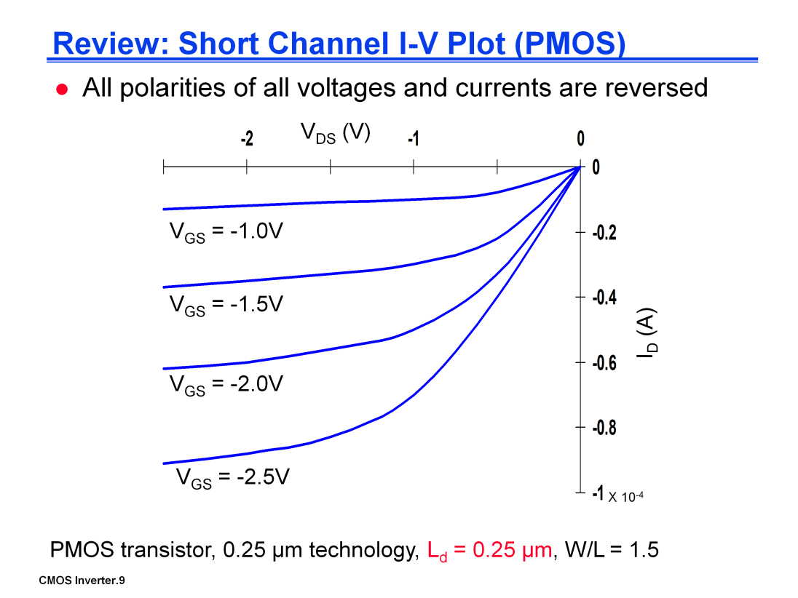
All the derived equations hold for PMOS – polarities of all voltages and currents are reversed however.
Due to lower hole mobility (resulting in smaller |k’_{p}|), the maximum current is only 42% of what is achieved by a similar NMOS transistor at |V_{DS}| = |V_{GS}| =
2.5 V. For PMOS, |I_{D}| ~ 92 μA but for NMOS I_{D} ~ 220 μA. See p. 18 MOSFET
transparency.
Effects of velocity saturation are less pronounced than in NMOS. The spacing
between the different curves can be considered quadratic, similar to I-V curve
of long-channel devices. The effect is not significant due to smaller mobility of
holes compared to that of electrons. Smaller hole mobility causes ξ_{c} to be
higher.

Slide 5
DC points located at the intersection of the corresponding load lines.
Note all operating points are located either at the high or low output levels.

Slide 6
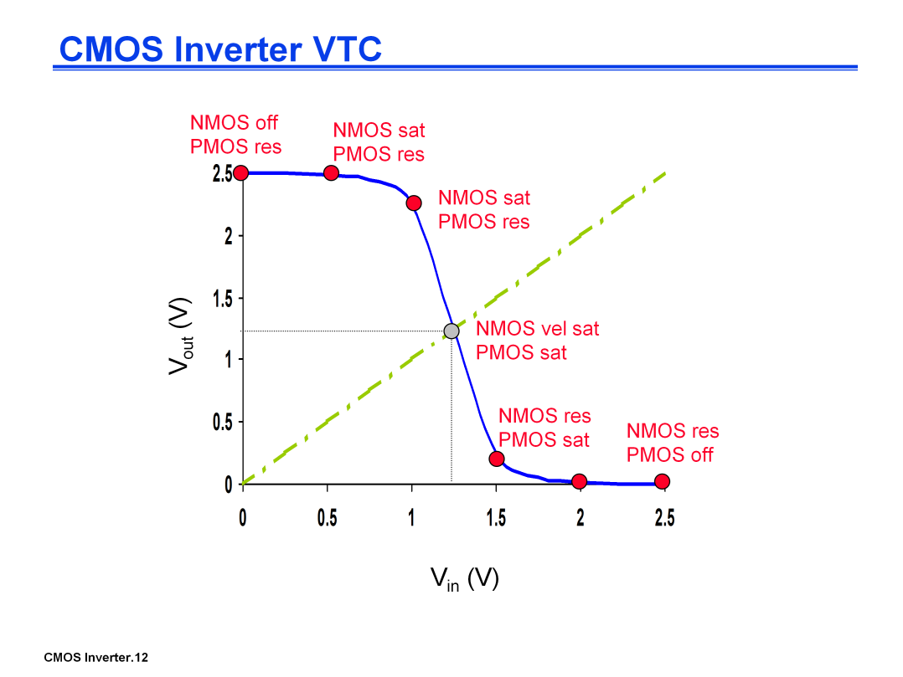
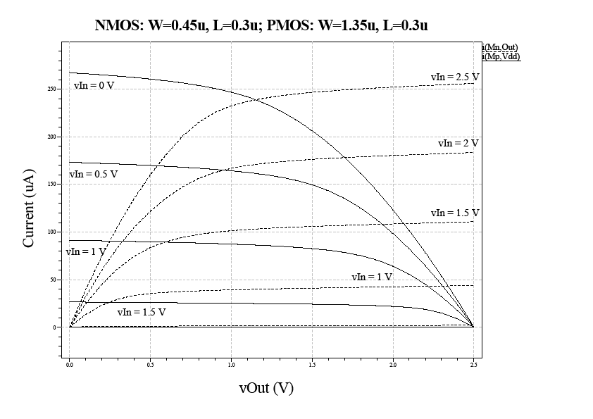
VTC of the inverter exhibits a very narrow transition zone; high gain during switching transient (when both PMOS and NMOS are simultaneously on and in saturation). In that region, a small change in input voltage results in a large output voltage variation.

Slide 7
Response determined mainly by the output capacitance of the gate, C_{L}. C_{L} is made up of drain diffusion capacitance of the NMOS and PMOS transistors, the connecting wires, and the input capacitances of the fan-out gates (if output is used to drive other gates).
A fast gate is built either by keeping the output capacitance small or by decreasing the on-resistance of the transistor (or both).
Decreasing the on-resistance is achieved by increasing the W/L ratio of the devices (up to a certain degree).
Be aware that the on-resistance of the NMOS and PMOS transistors is not constant; rather it is a nonlinear function of the voltage across the transistor.

Slide 9
References:
The VeCAD (VLSI – eCAD) from FKE, UTM, MALAYSIA, 2012
2. Jimmie J. Cathey, Ph.D, Theory and Problems of Electronic Devices and Circuits, 2nd Edition, 2002.
3. J. M. Rabaey, A. Chandrakasan and B. Nikolic, Digital Integrated Circuits: A Design Perspective. 2nd ed. Upper Saddle River, NJ: Pearson Education, Inc., 2003.
4. S-M. Kang and Y. Leblebici, CMOS Digital Integrated Circuits. 3rd ed. Singapore: McGraw-Hill,
2005.

